Slide 1
Performance-aware Scheduling for Heterogeneous Deep Learning Clusters
Deepak Narayanan, Keshav Santhanam, Amar Phanishayee, Matei Zaharia

Slide 2




A view of modern clouds
Are batch processing schedulers a good fit for deep learning training?
Deep learning training workloads
Cluster Scheduler
Heterogeneous accelerator platforms

Slide 3
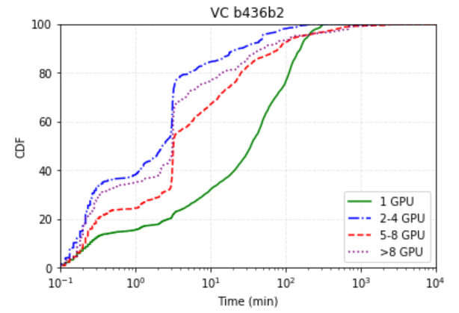
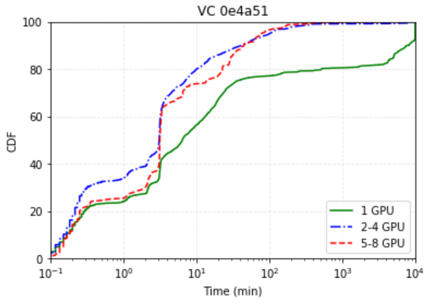
Queuing delay in deep learning clusters
Queuing delay >10 minutes for >60% of
single-GPU jobs in a homogeneous cluster!
[1] Myeongjae Jeon, et al., Analysis of large-scale multi-tenant GPU clusters for DNN training workloads, 2019 USENIX Annual Technical Conference (USENIX ATC 19) (Renton, WA), USENIX Association, 2019, pp. 947–960.

Slide 4
Job Queue
Job Resource Requirements
2
Job ID
GPU type
0
V100
In the reservation-based scheme, Job 2 is stuck waiting for the V100 to be made available
1
1
K80
0
2
V100
V100
P100
K80
Time

Slide 5
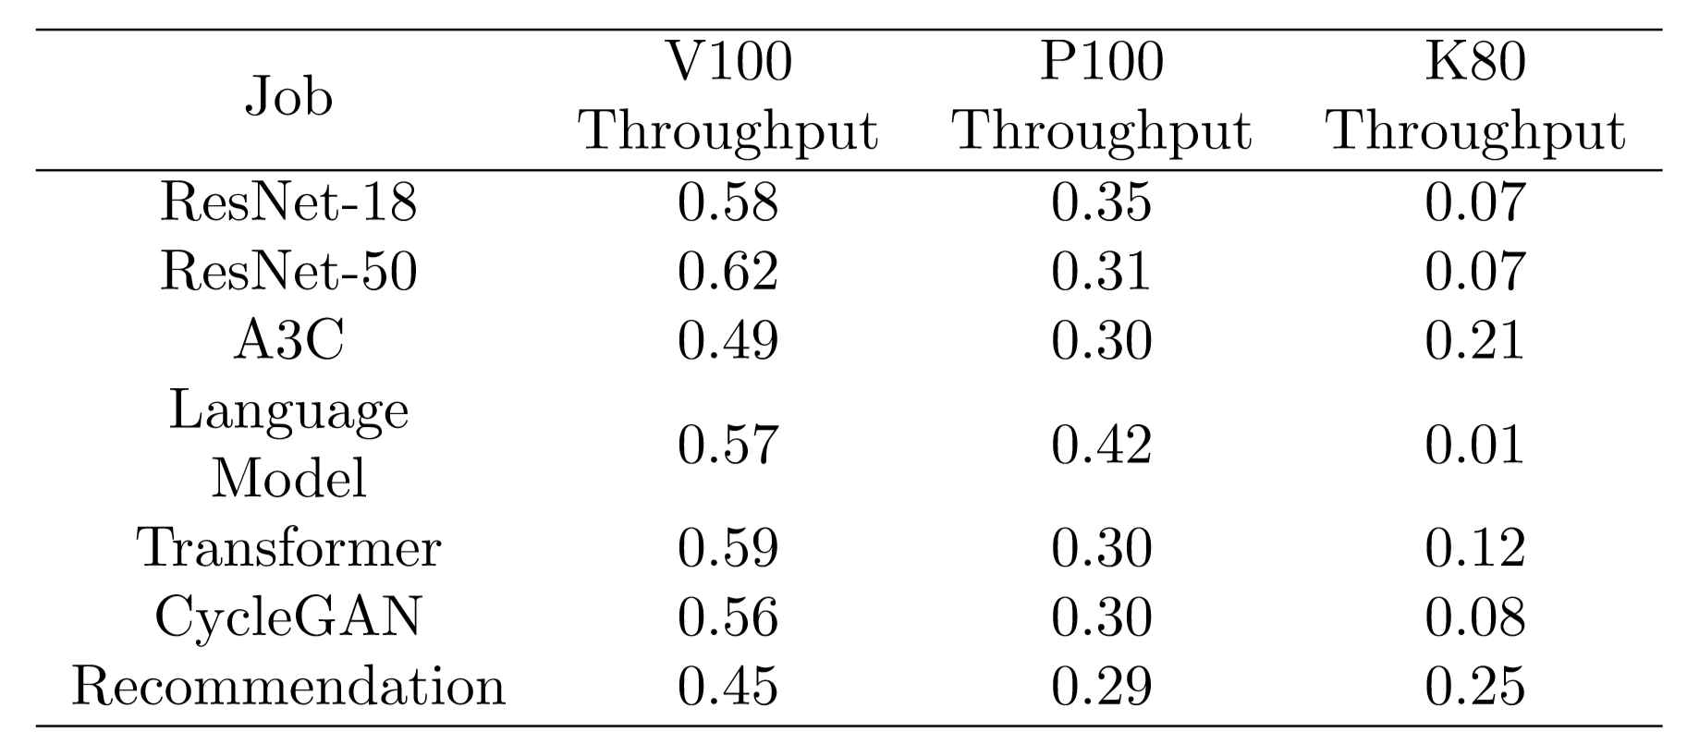
Performance characteristics of DL models
Resource utilization
Throughput
Many workloads severely underutilize hardware resources
Workloads have different affinities for different hardware platforms
[2] Cody Coleman, Daniel Kang, Deepak Narayanan, et al., Analysis of DAWNbench, a time-to-accuracy machine learning performance
benchmark, ACM SIGOPS Operating Systems Review 53 (2019), no. 1, 14–25.

Slide 6
Job Queue
Job Resource Requirements
2
Job ID
GPU type
0
V100
If we naively ignore resource demands, Job 2 gets stuck running on a K80 instead of a V100
1
1
K80
0
2
V100
V100
P100
K80
Time

Slide 7
Scheduling primitives
Time-slicing
Share exclusive access to resource between different jobs
Packing
Share resource between different jobs concurrently
0
0
1
1
V100
V100
Time
Time
[2] Juncheng Gu, et al., Tiresias: A GPU cluster manager for distributed deep learning, 16th USENIX Symposium on Networked Systems Design and Implementation (NSDI 19), 2019, pp. 485–500.
[3] Wencong Xiao, et al., Gandiva: Introspective cluster scheduling for deep learning, 13th USENIX Symposium on Operating Systems Design and Implementation ({OSDI} 18), 2018, pp. 595–610

Slide 8
How do we apply the time-slicing and packing primitives in a principled manner to efficiently allocate heterogeneous hardware resources to heterogeneous workloads?

Slide 9
Critical questions
Without reservations, how do we decide which resources are best for each job?
How do we distribute resources among jobs “most effectively”?
Given churn (jobs and machines), how do we ensure that each job gets its allocated resources?
If we know which resource type to give each job, how do we select which machines to send them to?
Performance Estimator
Policy
Scheduling Mechanism
Placement Mechanism

Slide 10
System Design
V100
1
2
Throughput Tensor
Allocation
Placement
P100
Job Queue
Performance Estimator
Policy
Scheduling Mechanism
Placement Mechanism
0
4
3
2
1
0
4
K80
3
Job Throughputs

Slide 11
Performance Estimator
?
V100
Job Queue
?
How well does a newly arrived job perform on each worker type?
3
?
P100
K80

Slide 12
Performance Estimator
?
0
V100
Job Queue
?
How well does a newly arrived job
co-locate with other jobs?
3
1
?
P100
2
K80

Slide 13
Performance Estimator
Goal: Construct a 3D tensor that captures the performance of each job on each worker type in isolation and co-located with all other active jobs
Isolated
Job n-1
Job 0
Job 1
…
K80
P100
V100
Job 0
10.2
-
0.21
0.49
Job 1
0.28
0.13
-
0.15
…
Job n-1
137.9
0.81
0.68
-
Normalized

Slide 14
Performance Estimator
Isolated
Job n-1
Job n
Job 0
Job 1
…
Job 0
Job 1
…
Job n-1
K80
K80
P100
P100
V100
V100
Job 0
10.2
-
0.21
0.49
Job 0
10.2
-
0.21
0.49
Job n arrives
Job 1
0.28
0.13
-
0.15
Job 1
0.28
0.13
-
0.15
…
…
Job n-1
137.9
0.81
0.68
-
Job n-1
137.9
0.81
0.68
-
Job n
Need to fill in O(kn) entries – do we have to profile all of these?

Slide 15
Performance Estimator
Isolated
Can we use a few new measurements and previous data to fill in missing entries?
Job 0
Job 1
…
Job n-1
Job n
K80
P100
V100
Job 0
10.2
-
0.21
0.49
Tensor completion – used previously by Delimitrou, et al. (Quasar, ASPLOS 2014)
Job 1
0.28
0.13
-
0.15
…
Job n-1
137.9
0.81
0.68
-
Job n
122.6
0.75
0.70
?
Next steps: How to bootstrap the measurements and balance between profiling overhead/accuracy

Slide 16
Policies
Scheduler | Supported policy/objective metric
Philly | FIFO
Gandiva | Makespan
Tiresias | Least Attained Service
Themis | Finish-time Fairness
How do we make these policies heterogeneous performance-aware?
Can we introduce new policies that are enabled by the heterogeneous regime?

Slide 17
Policies
Example: FIFO
Performance-aware FIFO: Schedule job on best available resource
Performance-aware + packing FIFO: Schedule as many jobs in isolation as possible and then pack jobs with already scheduled jobs
What if we want to explicitly optimize an objective metric?

Slide 18
Policies
Example: Maximize minimum effective throughput (MaxMinFairness)
V100
P100
K80
V100
P100
K80
Normalized
Job 0
100
60
40
Job 0
0.5
0.3
0.2
Job 1
80
100
20
Job 1
0.4
0.5
0.1
Maximize minimum between:
0.5x₁ + 0.3x₂ + 0.2x₃ (effective throughput of Job 0)
0.4y₁ + 0.5y₂ + 0.1y₃ (effective throughput of Job 1)
x₁ + y₁ ≤ # V100s (Cannot use more than the total # of V100s)
x₂ + y₂ ≤ # P100s (Cannot use more than the total # of P100s)
x₃ + y₃ ≤ # K80s (Cannot use more than the total # of K80s)
x₁ + x₂ + x₃ ≤ 1 (Job 0 cannot run for more than 100% of the total time)
y₁ + y₂ + y₃ ≤ 1 (Job 1 cannot run for more than 100% of the total time)
Subject to:

Slide 19
Policies
Result of optimization problem is the resource allocation
Allocation provides distribution of resources to jobs that maximizes the given utility metric
Example:
V100
P100
K80
Job 0
0.1
0.2
0.7
Job 0 should spend 10% of its time on a V100, 20% of its time on a P100, and 70% of its time on a K80
Job 1
0.5
0.4
0.1
Job 2
0.4
0.4
0.2
How do we enforce this allocation in practice?

Slide 20
Scheduling Mechanism
Instantaneous scheduling decisions are only locally optimal
Instead, periodically make global scheduling decisions at the granularity of rounds
After each round ends, re-schedule all active jobs

Slide 21
Job Queue
2
By introducing fixed interval rounds we can alter our scheduling decisions over time
1
0
V100
P100
K80
Time

Slide 22
Job Queue
2
The scheduler must decide what to schedule in each round
What happens if there are more jobs than available resources?
1
0
3
V100
P100
K80
Time

Slide 23
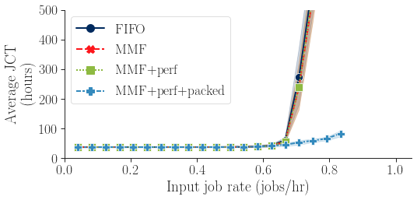
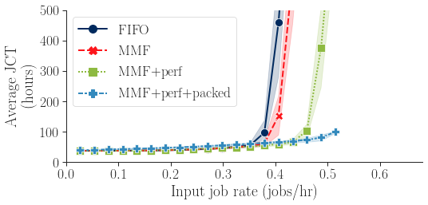
Evaluation
25 V100s
8 V100s, 8 P100s, 8 K80s

Slide 24
Future Work
Implement and evaluate additional policies
Investigate best practices for online throughput estimation
Evaluate on real cluster

Slide 25
Conclusion
Deep learning training workloads have diverse performance characteristics and run on heterogeneous hardware platforms
We propose a scheduler that leverages the primitives of time-slicing and packing to efficiently allocate heterogeneous hardware resources
Our scheduler uses online throughput estimates as input to scheduling policies which can be expressed as optimization problems

Slide 26
Questions?

Slide 27
In progress slides follow

Slide 28
Introduction
Deep learning (DL) is a key cloud computing workload
Many organizations maintain clusters specifically to support DL training jobs
Determining how best to schedule DL jobs onto cluster resources presents a new challenge for systems researchers

Slide 29
Traditional scheduler workflow
Job Queue
2
1
0
Job Resource Requirements
Cluster Scheduler
Job ID
CPU
Memory
0
2
4
1
4
4
2
2
1
4 GB
12 GB
4 GB
4 GB
4 GB
8 GB
16 GB
4 GB
4 GB

Slide 30
Deep learning scheduler workflow
Job Queue
2
1
0
Job Resource Requirements
Cluster Scheduler
Job ID
GPU type
0
V100
1
K80
2
V100
V100
P100
K80

Slide 31
How does the scheduler decide what to run?
Suppose we know how well each job performs on each hardware type
TODO: insert throughput matrix here
Suppose we have some global optimization metric (e.g. minimize average job completion time)

Slide 32
How does the scheduler decide what to run?
We can represent the scheduling decision as an optimization problem
Example:
TODO: insert example here
This can be solved using a standard LP solver (e.g. cvxpy)

Slide 33
Existing deep learning cluster schedulers
Gandiva [Xiao et al., OSDI 18]
Uses time-slicing and packing but uses ad-hoc process for deciding how/when to use these mechanisms
Tiresias [Gu, et al. NSDI 19]
Uses a principled methodology for time-slicing but does not address packing
Themis [Mahajan, et al.]
TODO: clarify with Amar about what is actually done here
No existing deep learning scheduler leverages heterogeneity

